Slide 1
JAVA PROGRAMMING

Slide 2
PROFESSOR AND MEMBERS GROUP2 AMS-A
MENBERS
CHEA ROTHA
CHORN CHANLAKHNA
AOV KEAT MENG
HEANGPA VISAL
KHON YIN SAKAL
PROFESSOR ®
Dr : CHAN SOPHAL
OOP TP
Department Apply Mathemetics And data science
AMS A-Group 2

Slide 3

HELLO!
I am from group 2 AMS-A
I am here because I love to give presentations.

Slide 4
CONTENT
Local Variable
Instance Variable
Class / Static Variable
questoin.

Slide 5
Java is a popular programming language, created in 1995. It is owned by Oracle, and more than 3 billion devices run Java. It is used for:
Mobile applications (specially Android apps)
Desktop applications
Web applications
Web servers and application servers
GamesDatabase connectionAnd much, much more!

Slide 6
Types of Variable
.
Local variable: This is a variable that is declared inside the body of a method.
Instance variable: This Java variable is defined without the STATIC keyword, but as outside of a method declaration. They are object-specific variables, which is why they are known by this name.
Static variable: This variable is initialized only once, just when the program execution starts. It is the variable that should be initialized first, especially before an instance variable is initialized.

Slide 7
1.Local Variable
Let’s start with the first set of slides

Slide 8
A local variable is a type of variable that can be used where the scope and extent of the variable is within the method or statement block in which it is declared
Local Variable are declared in methods, constructors, or blocks
Local Variables are visible only within the declared method, constructor, or block.
Local Variable will be destroyed once it exits the method, constructor, or block.
There is no default value for local variables, so local variables should be declared and an initial value should be assigned before the first use.
Local Variables are variables that are specific to a certain block of code

Slide 9
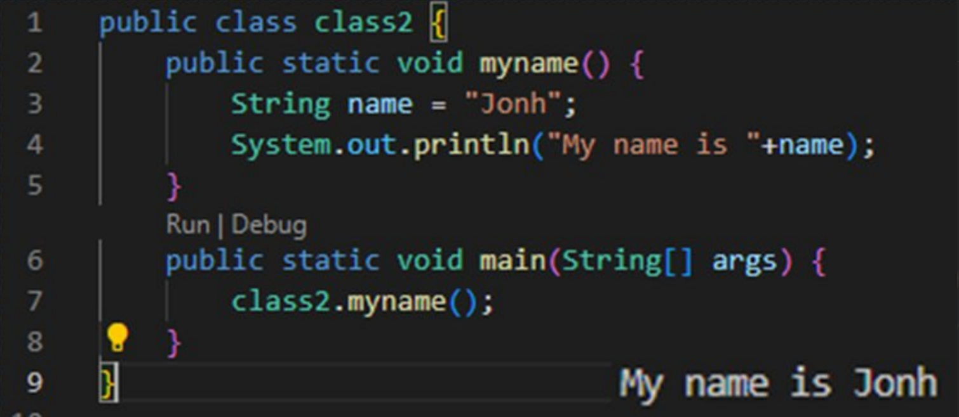
Example Local Variable

Slide 10
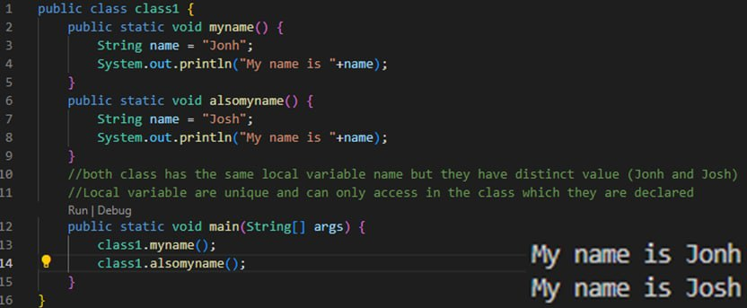
Exmaple Instance Variable

Slide 11
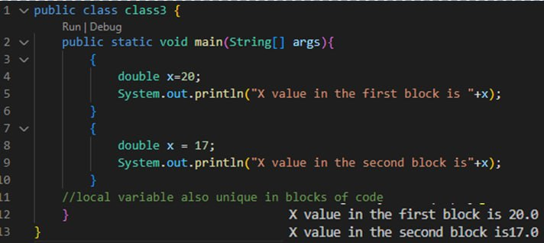
89,26,124
185,244 users
100%
Example class / static Vairiable

Slide 12
2.INSTANCE VARIABLE
What is a instance in Java?
Java instances and instance variables
Java is a specific class, and a physical manifestation of this class can be called an instance. Instances of a class have the same set of attributes. However, each instance may be different because of what's inside each attribute.

Slide 13
Instance Variable
Instance variables are declared in a class, but outside a method, constructor or any block.
Instance variables are created when an object is created with the use of the keyword 'new' and destroyed when the object is destroyed.
Instance variables hold values that must be referenced by more than one method, constructor or block, or essential parts of an object's state that must be present throughout the class.
The instance variables are visible for all methods, constructors and block in the class. Normally, it is recommended to make these variables private (access level).
Instance variables have default values. For numbers, the default value is 0, for Booleans it is false, and for object references it is null. Values can be assigned during the declaration or within the constructor.
Instance variables can be accessed directly by calling the variable name inside the class. However, within static methods (when instance variables are given accessibility), they should be called using the fully qualified name. ObjectReference.VariableName.
http://www.instanceofjava.com/2018/01/instance-variables-in-java-example.html

Slide 14
3.Class / Stitic Variable
Static variable in Java is variable which belongs to the class and initialized only once at the start of the execution. It is a variable which belongs to the class and not to object(instance ). Static variables are initialized only once, at the start of the execution. These variables will be initialized first, before the initialization of any instance variables.
A single copy to be shared by all instances of the class
A static variable can be accessed directly by the class name and doesn’t need any object.

Slide 15
Class variables also known as static variables are declared with the static keyword in a class, but outside a method, constructor or a block.
Static variables are rarely used other than being declared as constants. Constants are variables that are declared as public/private, final, and static. Constant variables never change from their initial value.
Default values are same as instance variables. For numbers, the default value is 0; for Booleans, it is false; and for object references, it is null. Values can be assigned during the declaration or within the constructor. Additionally, values can be assigned in special static initializer blocks.
Static variables can be accessed by calling with the class name ClassName.VariableName

Slide 16
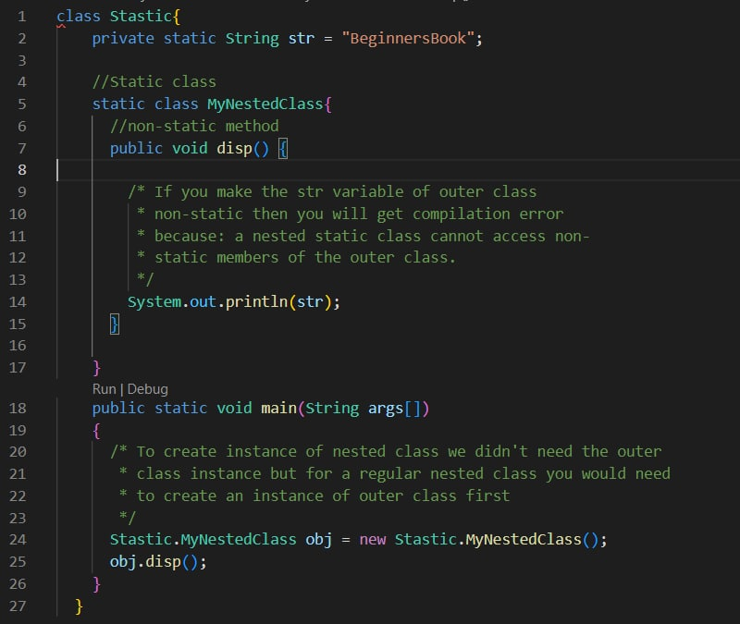

Example for Instace variable
Out put

Slide 18


THANKS!
Any questions?

